Slide 1
Driving the 28BYJ-48 Stepper motor and ULN2003 Board with an Arudino
Bret Stateham
Microsoft Technical Evangelist
BretStateham.com
@BretStateham

Slide 2
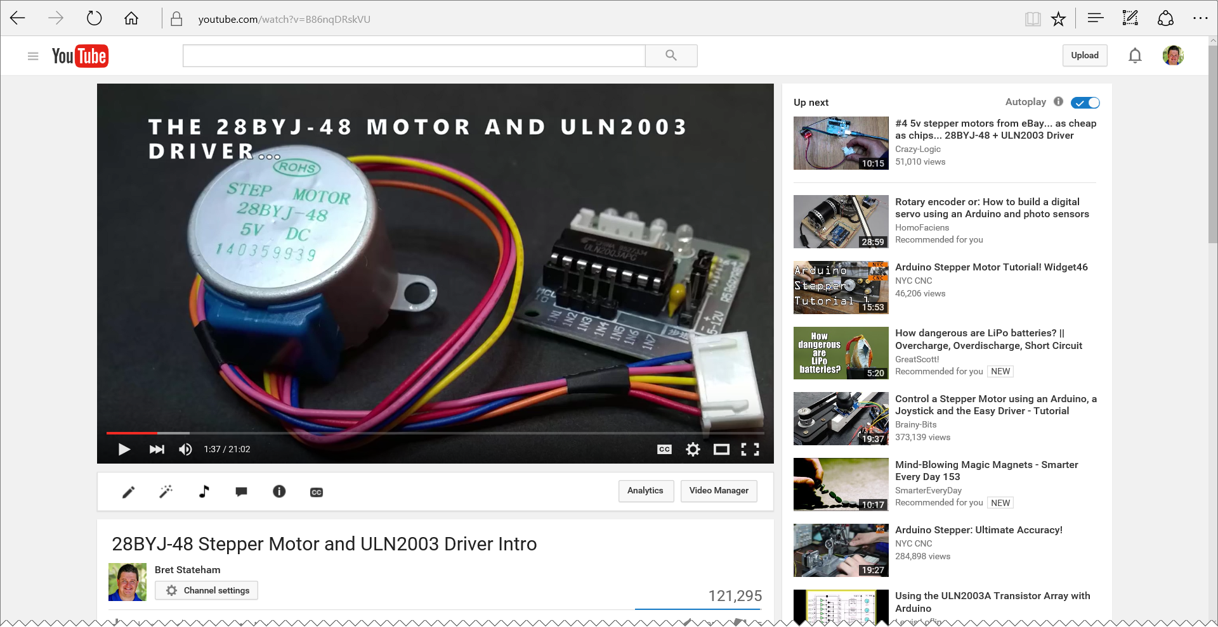
Overview video
http://aka.ms/28byj

Slide 3
HOOKING IT ALL UP
Connect IN1-IN4 on the ULN2003 board to Digital Output pins 2-5 Respectively on your Arduino.
Use a separate power source for the motor. Just do it.
2
3
4
5

Slide 4
Stepping methods
STEPS
METHODS
PHASES
1
2
3
4
5
6
7
8
WAVE DRIVE One phase at a time Simplest, but least used
BLUE
PINK
YELLOW
ORANGE
FULL STEP Two phases at a time Strongest Torque
BLUE
PINK
YELLOW
ORANGE
HALF STEP One, or two phases at a time
Smallest step angle Medium torque
BLUE
PINK
YELLOW
ORANGE

